Slide 1
MENTAL HEALTH (self-harm)
QUALITY IMPROVEMENT PROJECT 2019/20
National Results

Slide 2
Contents
This presentation shows how EDs are performing against the standards and variation over the QIP period.
For further information please see the national report at www.rcem.ac.uk/audits.

Slide 3
Audit objectives
To identify current performance in EDs against clinical standards and show the results in comparison with performance nationally and in the ED’s country in order to facilitate quality improvement.
To empower and encourage EDs to run quality improvement (QI) initiatives based on the data collected and assess the impact of the QI initiative on their weekly performance data.

Slide 4
Standards
Standard | Standard type
1. Patients should have mental health triage on arrival to briefly gauge their risk of self-harm or suicide and risk of leaving the department before assessment or treatment is complete. This is used to determine what level of observation the patient requires whilst in the ED. | Fundamental
2. Patients at medium or high risk of suicide, harm or of leaving before assessment and treatment are complete should be observed closely whilst in the ED. There should be documented evidence of action to mitigate risk, such as continuous observation or intermittent checks (for example every 15 minutes), whichever is most appropriate. | Developmental
3. When an ED clinician reviews a patient presenting with self-harm or a primary mental health problem, they should record a brief risk assessment of suicide and further self-harm. | Developmental

Slide 5
Performance summary
This section shows the national performance against standards for this QIP
You will see the mean for the QIP period, as well as the variation each week on an SPC chart.
↑ Higher scores (e.g. 100%) indicate higher compliance with the standards and better performance.

Slide 6
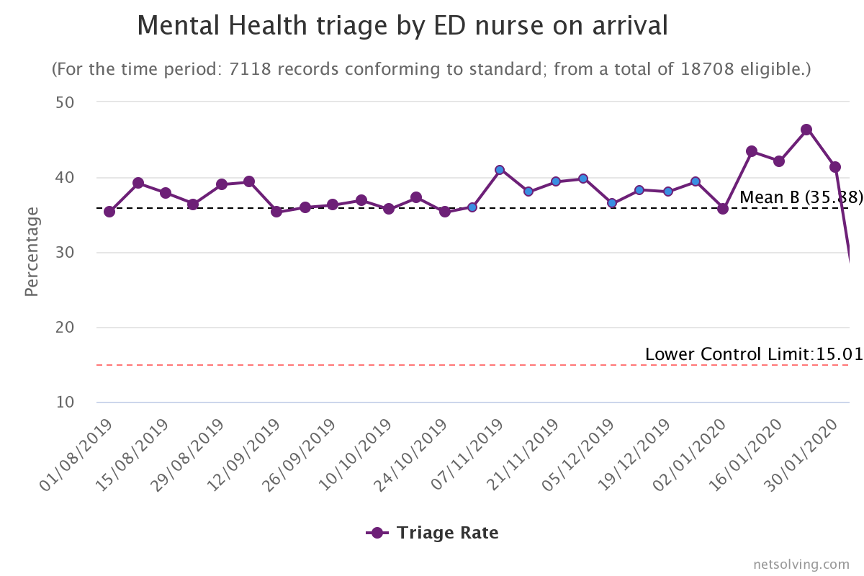
Clinical findings
STANDARD 1:
Patients should have mental health triage on arrival to briefly gauge their risk of self-harm or suicide and risk of leaving the department before assessment or treatment is complete. This is used to determine what level of observation the patient requires whilst in the ED

Slide 7
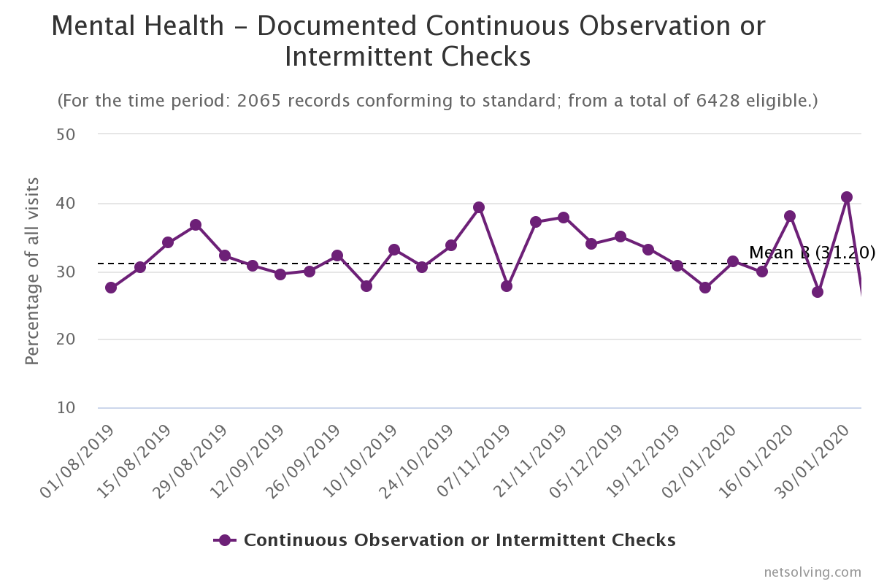
Clinical findings
STANDARD 2:
Patients at medium or high risk of suicide, harm or of leaving before assessment and treatment are complete should be observed closely whilst in the ED. There should be documented evidence of action to mitigate risk, such as continuous observation or intermittent checks (for example every 15 minutes), whichever is most appropriate.

Slide 8
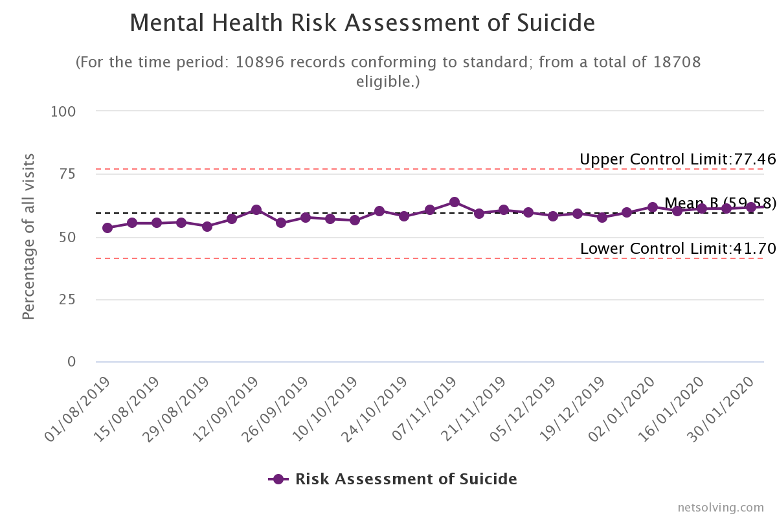
Clinical findings
STANDARD 3:
When an ED clinician reviews a patient presenting with self-harm or a primary mental health problem, they should record a brief risk assessment of suicide and further self-harm.

Slide 9
Recommendations
In line with RCEM standards, every ED should have a named mental health lead.
Every ED should have a mental health process and policy for assessing all mental health patients.
Every ED should have a safe area for mental health patients to be observed, which is safe and calm.
Review effectiveness of PDSA cycles and engage all ED staff in this process.

Slide 10
Next steps
Read the full report at www.rcem.ac.uk/audits
Action planning
Rapid cycle quality improvement
Contact other EDs for tips & solutions

